Slide 1

Two-Wheeler Business Intelligence Report
Analyzing bike sales and resale data to uncover brand performance, price trends, and market insights through SQL and Tableau.

Slide 2

PROJECT GOALS
Business Objectives
Sales Performance
Resale Contribution
Analyze bike sales across different brands to identify market leaders.
Understand each brand's contribution to total resale value.
Year Comparison
Pattern Recognition
Compare sales across manufacturing years to spot trends.
Identify trends in resale prices for data-driven decisions.

Slide 3

Technology Stack
1
SQL
Data extraction, aggregation, and complex analysis queries.
2
Tableau
Interactive dashboards and visual insights creation.
3
Excel
Initial data review and basic cleaning operations.
4
Git & GitHub
Version control and project tracking via Visual Studio Code.

Slide 4

DATA FOUNDATION
Dataset & Pre-processing
01
02
Dataset Attributes
Data Verification
Brand, Model, Year of manufacture, Resale price, and Sales records from historical transactions.
Verified data types, consistency, and removed missing or invalid values.
03
Standardization
Standardized brand names and ensured resale price values were numeric and accurate.

Slide 5





SQL Analysis Approach
Total Resale Value
Analyzed overall brand performance through total resale calculations.
Contribution Analysis
Calculated each brand's percentage share in total resale revenue.
Time-Based Trends
Compared sales across manufacturing years to identify patterns.
Aggregation
Performed brand-wise and year-wise analysis to study growth over time.

Slide 6
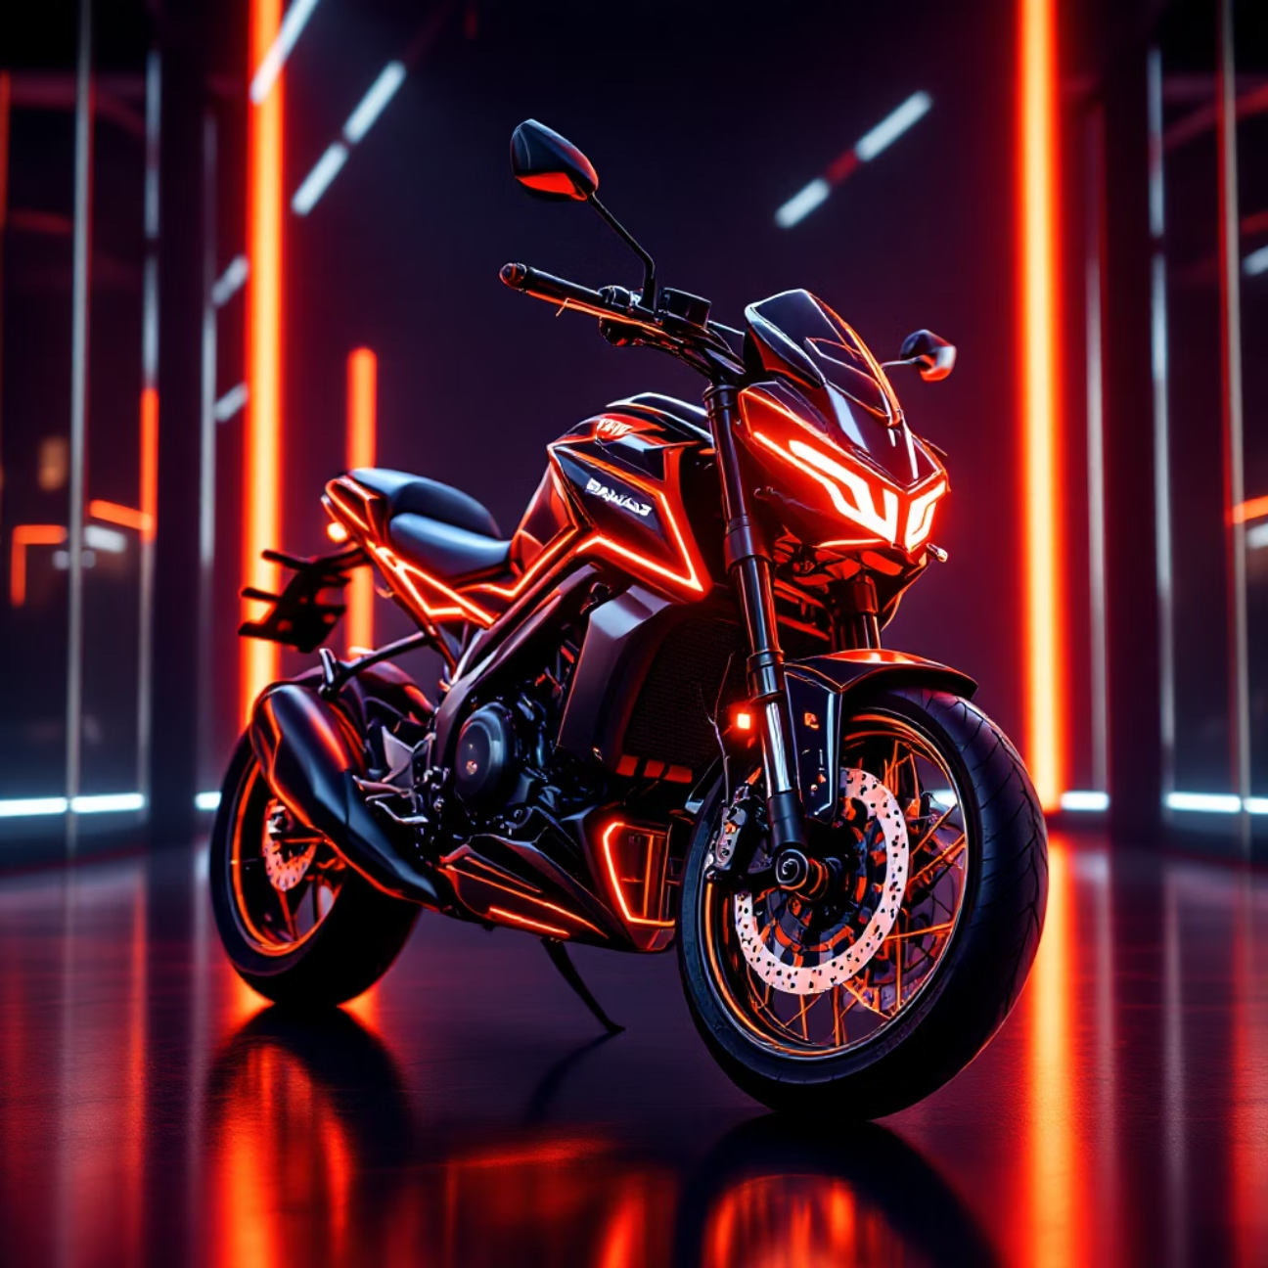
SQL QUERY
Above-Average Sales Analysis
Query Objective
Find brands with average resale prices higher than the overall market average.
select brand, avg(resale_price)
from bike_sales
group by brand
having avg(resale_price) >
(select avg(resale_price)
from bike_sales)
limit 1
Result
Bajaj leads with an average resale price of ₹136,662.36, exceeding the market average.

Slide 7
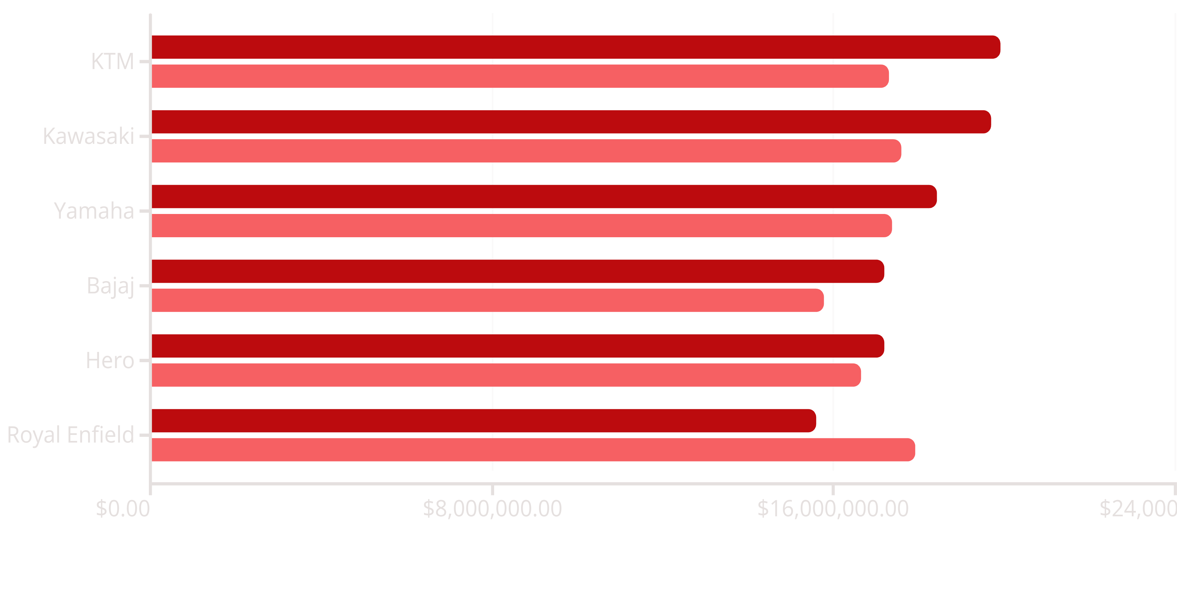
YEAR-OVER-YEAR
2024 vs 2023 Sales Comparison
2024
2023
2023
Most brands show growth in 2024, with KTM leading at ₹19.9M. Royal Enfield declined from ₹17.9M to ₹15.6M.

Slide 8
Interactive Tableau Dashboard
Multi-Dimensional Analysis
Average price vs resale price comparison, top brands by resale value, and year-wise trends.
Geographic Insights
State-wise resale value distribution with interactive map visualization.
Fuel Type Breakdown
Resale value analysis across Petrol, Diesel, and Electric segments.
Interactive Filters
Dynamic filtering by brand, state, and year for customized insights.

Slide 9

PROJECT COMPLETE
Key Takeaways & Impact
Data-Driven Insights
SQL and Tableau integration enables comprehensive analysis of sales trends, brand performance, and resale value behavior.
Market Intelligence
Identified balanced market share across brands with growth opportunities in specific segments.
Version Control
Git and GitHub ensure secure storage, change tracking, and easy collaboration through Visual Studio Code.
Business Value
Supports strategic decision-making through interactive visualizations and actionable market insights.

